Slide 1

Goodness Me, Goodness You!
Short-Term Preparation for Teaching and Learning (My Stories)

Slide 2


Rationale
Why prepare for teaching and learning in GMGY?
Curriculum
Learning Outcomes
Why prepare for GMGY on a short-term basis?
Lessons
Classroom Environment
Notes:
GMGY is a curriculum as opposed to a programme. As such, it does not take a prescriptive approach to supporting children’s learning through predetermined lessons or activities.
GMGY provides learning outcomes, organised by strands and elements. This structure provides autonomy and flexibility to teachers as committed, skilful and agentic professionals to prepare responsive learning experiences for the children in their class, but requires teachers to take time to prepare in advance.
Engaging in preparation for teaching and learning in GMGY on a short-term basis ensures that GMGY lessons are responsive to the evolving needs of children and the whole school context. This preparation also ensures that the classroom environment is supportive and reflective of children’s learning experiences in the patrons’ curriculum.

Slide 3

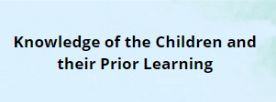



What should underpin preparation for GMGY?
Notes:
When preparing for teaching and learning in GMGY, teachers should consider The Key Pillars of Preparation for Teaching and Learning. These Key Pillars are outlined in the document “Preparation for Teaching and Learning: A Guide for All Primary and Special Schools” published in 2021.
These 3 Key Pillars are:
Knowledge of the children and their Prior Learning
Knowledge of the Curriculum
Knowledge of the Pedagogies Underpinning the Curriculum
As GMGY is the curricular expression of the CNS ethos, it is also vital that teachers bear the CNS ethos in mind when preparing for the patrons' curriculum.
With specific regard to short-term preparation for GMGY, CNS teachers should also bear long-term preparation for teaching and learning in GMGY in mind.

Slide 4



How do teachers prepare for teaching and learning in GMGY?
Notes:
Preparation for teaching and learning in GMGY is an ongoing process which involves invisible, visible and recorded preparation. As with other curricular areas, preparation for teaching and learning in GMGY will involve all three of these components, all of which are equally valued.
Invisible preparation is continuous, unrecorded and involves teachers making ongoing decisions before, during and after learning.
Visible preparation is teaching and learning in action. It involves the provision of appropriate learning experiences to support the intended learning of all children.
Recorded preparation is any documentation which supports teachers’ ongoing practice and reflection.

Slide 5




Invisible Preparation
Notes:
When preparing for teaching and learning in GMGY in an invisible way, teachers might:
Consider their knowledge of the children, their prior learning and current needs before, during or after teaching and learning has taken place
Draw of their engagement with children, parents, colleagues and other relevant professionals and adjust their approaches and methodologies accordingly
Draw on their knowledge of the curriculum or their prior experience of teaching a particular strand or element of GMGY to inform their approaches
Reflect on formative assessment of children’s learning (e.g. observation or conferencing) and use this information to inform the next steps in children’s learning.

Slide 6






Visible Preparation
Notes:
Visible preparation for GMGY might involve:
Sourcing resources (e.g. stories, artefacts, photographs, videos, games, toys etc.)
Creating resources (e.g. posters, presentations, graphic organisers/worksheets, flashcards)
Creating school/classroom displays, including displays of children’s work
Liaising with classroom visitors to contribute to GMGY lessons
Modelling skills and dispositions for upcoming GMGY lessons
Engaging children in alternative learning experiences during GMGY to respond to emerging needs and interests
Engaging in professional learning on GMGY.

Slide 7

Recorded Preparation
Notes:
Recorded preparation is just one component of the preparation for teaching and learning process and equal consideration and significance should be afforded to invisible and visible preparation for teaching and learning.
Recorded Preparation for Teaching and Learning in GMGY might include:
Short-term plans (e.g. lessons, weekly plans, fortnightly plans, monthly plans)
Long-term plans (e.g. monthly plans, termly plans, yearly plans)
A Whole School GMGY Policy
Student support plans/IEPs
Assessment data
End of year reports
Personal notes
Documentation from other
professionals and outside agencies.

Slide 8

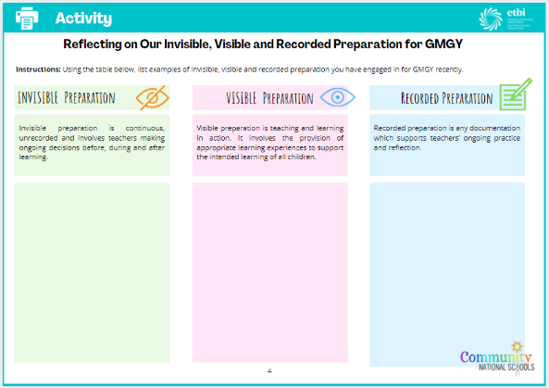
Activity
List examples of invisible, visible and recorded preparation you have engaged in for GMGY recently
Notes:
To reflect our current approach to preparation for teaching and learning in GMGY, we will now list examples of invisible, visible and recorded preparation we have engaged in for GMGY recently.
(Activity available in “Facilitating Short-Term Preparation for Teaching and Learning Guide for Coordinators” Booklet)

Slide 9
What does short-term preparation for GMGY entail?
preparing for lessons
a sustained period of teaching and learning
Key Considerations
What will the children learn? What will be their focus of new learning?
How will I facilitate this new learning? What learning experiences will I provide?
How will the children demonstrate this new learning? How will I assess the skills, concepts, values and dispositions they have developed?
Notes:
Short-term preparation for teaching and learning in GMGY involves teachers preparing for lessons. A lesson in GMGY is understood as a sustained period of teaching and learning which could range from a number of days to weeks. When preparing for GMGY on a short-term basis, CNS teachers will engage in invisible, visible and recorded preparation.
When engaging in invisible, visible and recorded preparation for GMGY lessons, some of the questions teachers are guided by include:
What will the children learn? What will be their focus of new learning?
How will I facilitate this new learning? What learning experiences will I provide?
How will the children demonstrate this new learning? How will I assess the skills, concepts, values and dispositions they have developed?
The remainder of this pack aims to provide guidance and opportunities for GMGY Coordinators to support teachers with these and other key questions.

Slide 10
How do you identify the focus of new learning?
expressed needs and interests of children
current local, national or international events
Unplanned learning experiences
New and interesting resources
GMGY Learning Outcomes
Notes:
Because GMGY provides autonomy and flexibility to teachers, there are a variety of ways they identify the focus of new learning for a GMGY lesson, which might include:
Responding to the expressed needs and interests of children
Building on current local, national or international events
Building on unplanned learning experiences within the classroom/school context
Identifying new and interesting resources
Unpacking GMGY learning outcomes

Slide 11

What Are Learning Outcomes?
statements in curriculum specifications to describe the skills, concepts, values and dispositions students should be able to demonstrate after a period of learning.
expected learning at the end of each two-year stage
broad statements which provide flexibility and agency for teachers to plan responsively by placing the child at the centre of learning
Learning outcomes are intended to be developed through a combination of explicit teaching and classroom culture
Notes:
Learning outcomes are statements in curriculum specifications to describe the skills, concepts, values and dispositions students should be able to demonstrate after a period of learning.
In GMGY, learning outcomes are broad statements which describe the expected learning at the end of each two-year stage. Within each stage, children explore 14 learning outcomes across four strands: My Stories; We Are A CNS; Thinking Time; and Beliefs and Religions.
Unlike objectives, learning outcomes are broad statements which provide flexibility and agency for teachers to plan responsively by placing the child at the centre of learning.
When preparing for GMGY on a short-term basis, teachers should select learning outcomes from stages which support children in working towards the next steps in their learning journey. These learning outcomes may be contained within the same or different stages of the curriculum. Furthermore, GMGY supports children to progress and work towards learning outcomes at a rate and pace appropriate to their abilities and to have this learning recognised.
Learning outcomes are intended to be developed through a combination of explicit teaching and classroom culture. As such, engagement in GMGY lessons is complemented by the general learning environment and vice versa.

Slide 12
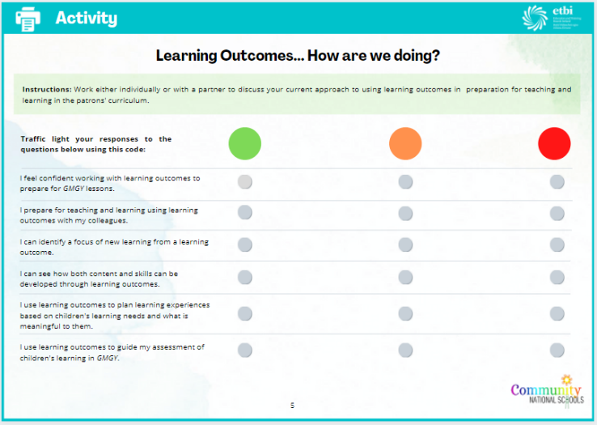
Notes:
To reflect on our use of learning outcomes to prepare for teaching and learning in GMGY, we will now complete the following activity.
(Activity available in “Facilitating Short-Term Preparation for Teaching and Learning Guide for Coordinators” Booklet)

Slide 13
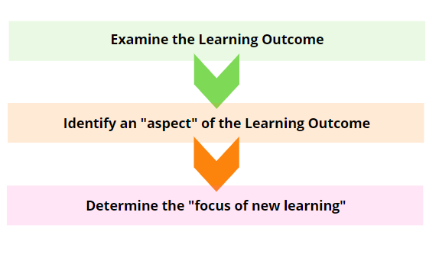
Using GMGY Learning Outcomes
Notes:
When preparing for GMGY on a short-term basis, teachers can engage in a process of “unpacking” learning outcomes. Bearing in mind their knowledge of the children and their prior learning, the GMGY curriculum, the pedagogies underpinning it as well as long-term documentation from their context, teachers examine the outcome and from there they identify the particular aspects of the learning-outcome they feel their class should focus on at a particular point in time and subsequently the focus of new learning for the lesson. The focus of new learning for a GMGY lesson can include various skills, concepts, values and/or dispositions.

Slide 14
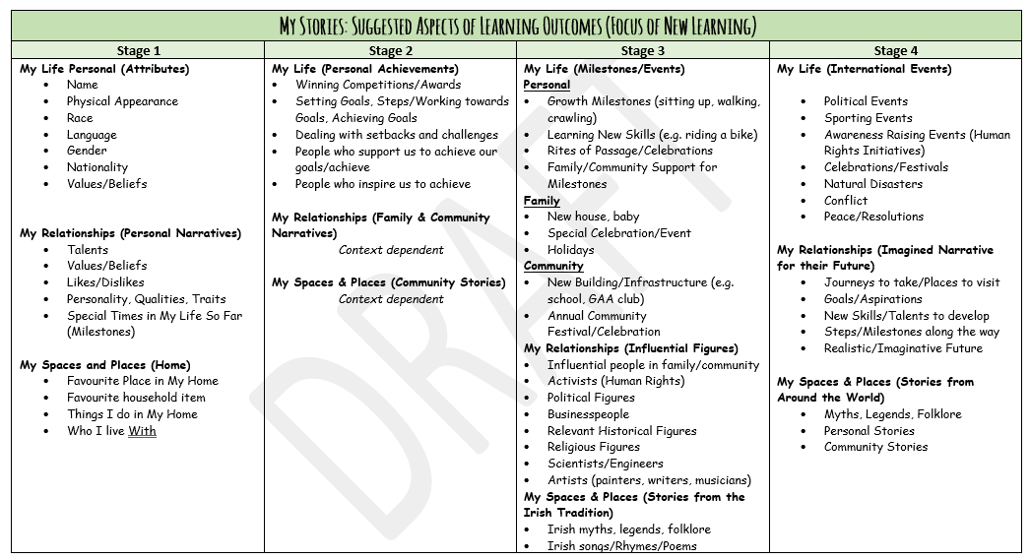
Suggested Focus of New Learning
Notes:
A list of suggested ways teachers might “unpack” learning outcomes are available to support your preparation for teaching and learning in GMGY.
(List available on GMGY Implementation Section of the Website)

Slide 15
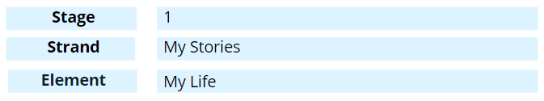
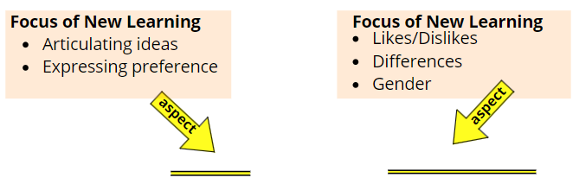
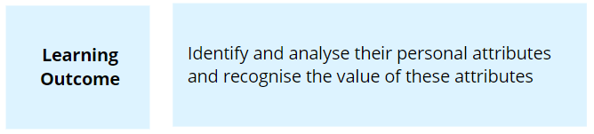
Using GMGY Learning Outcomes
Notes:
We will now consider how a teacher at Stage 1 might “unpack” the learning outcome shown here on screen.
When focusing on this learning outcome from Stage 1 > My Stories > My Life, a teacher might identify two aspects of the outcome to identify a focus of new learning.
In selecting these aspects, the teacher will aim for the children in their class too just identify their personal attributes through this lesson. When their identifying their personal attributes, teachers might be looking for children to articulate their ideas and express a preference or explore concepts such as their likes and dislikes, their differences, and gender.
Because children’s needs and contexts are different, teachers may identify a different aspect and focus of new learning to explore with their classes, even if working in the same school. Furthermore, given the broad nature of learning outcomes, it is likely that over a stage of the curriculum it will be necessary to revisit a single learning outcome on a number of occasions.
In summary, when preparing for GMGY lessons teachers may use learning outcomes as springboards for identifying the focus of new learning. Bearing in mind their knowledge of the children, teachers identify the aspects of learning outcomes that best respond to their needs and context at a particular point in time. When teachers prepare for GMGY lessons in this way, children then engage with the focus of new learning through relevant learning experiences.

Slide 16
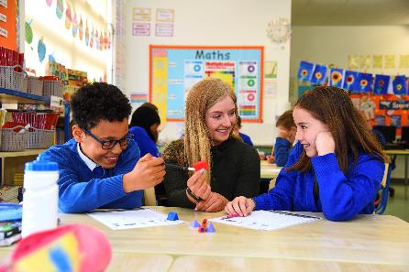

What are Learning Experiences?
Planned
Unplanned
Notes:
Learning experiences include the planned and unplanned opportunities through which children develop skills, concepts, dispositions and values in GMGY. Whilst unplanned learning experiences occur naturally within the general learning environment of the classroom, school, home and community, planned learning experiences for GMGY are explicitly facilitated through lessons and are intentionally prepared for on a short-term basis.
Learning Experiences:
vary depending on the focus of new learning for children
are informed by context and stage of the children’s learning journey
are shaped by the pedagogies and methodologies employed during the teaching and learning process as well as the resources utilised and general learning environment fostered
should provide children with equity of access, engagement and challenge in their learning

Slide 17
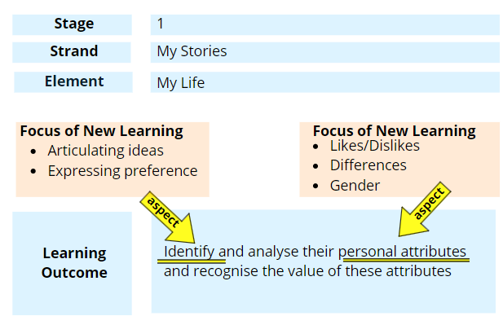
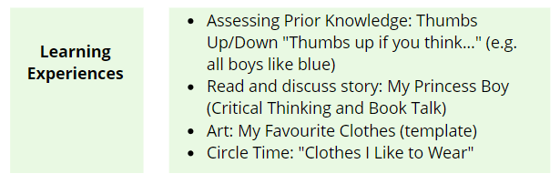
Developing Learning Experiences
Notes:
To meaningfully engage children in the focus of new learning identified for Stage 1 > My Stories > My Life earlier in this guide, a teacher might prepare for the following learning experiences
(Examine Learning experiences shown on PowerPoint)

Slide 18
How can teachers assess children’s learning in GMGY?
Learning outcomes should inform assessment of the patrons’ curriculum
Self-Assessment
Teacher Designed Tasks
Peer Assessment
Questioning
Observation
conferencing
Portfolios
Checklists
Notes:
Learning outcomes should inform assessment of the patrons’ curriculum. Because learning outcomes focus on the application and integration of knowledge and skills learned, learning outcomes point to appropriate modes of assessment. This approach ensures that assessment focuses on the essential skills, concepts, values or dispositions which children are exploring. As such, assessment for GMGY should allow teachers to gather information on new learning.
Formative and summative assessment of children’s learning in GMGY should inform the preparation for teaching and learning process and should be recorded as part of the teacher’s short-term plan. Approaches to assessment for GMGY are outlined on p. 30 of the curriculum.

Slide 19
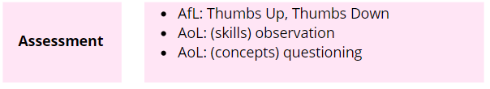
Assessing Learning
Notes:
To assess children’s ability to articulate their ideas about their likes, differences or concepts such as gender, teachers might adopted the following assessments of and for learning.
(Examine example shown and consider other ways to asses children’s learning of this outomce)

Slide 20
Short-Term Plans
lesson plan format or weekly, fortnightly or monthly
no prescribed template
one aspect of recorded preparation
documents the broad direction and focus of new learning
first and foremost for the teacher
should be useful, purposeful and practical
Tentative, dynamic works in progress
Notes:
Short-Term plans for GMGY can take a lesson plan format or weekly, fortnightly or monthly Approaches to short-term planning should be decided on a whole-school level.
There is no prescribe planning template for GMGY, but samples are available on the website.
Short-Term planning is just one aspect of recorded preparation.
Short-term plans should document the broad direction and focus of new learning.
As they are first and foremost for teacher, the level of detail will vary from teacher to teacher.
They should be useful, purposeful and practical and also understood a tentative, meaningful they can change as teaching and learning takes place.

Slide 21

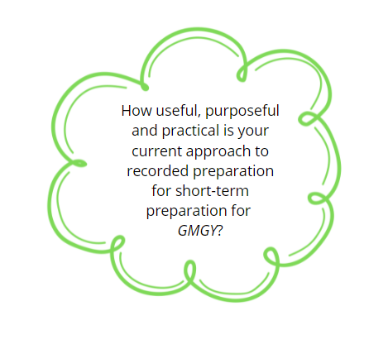
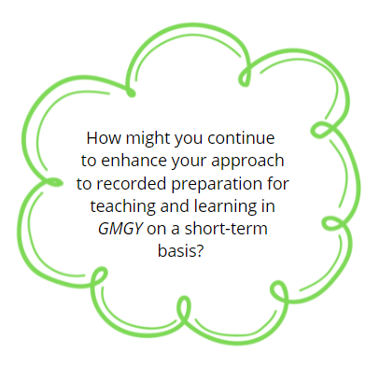
Discussion
Notes:
(Consider these questions with your staff)

Slide 22

Timetabling
GMGY should be taught for two hours per week (excluding other opportunities where GMGY is integrated across the curriculum)
Notes:
(Read key point on screen)

Slide 23
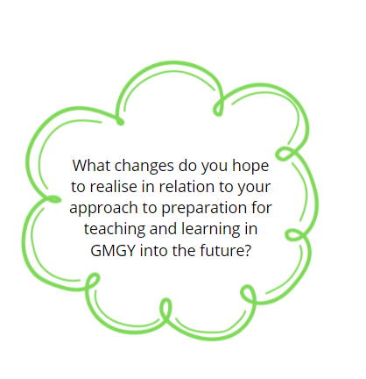
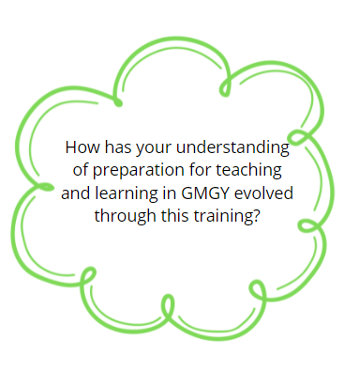
Discussion
Notes:
(Consider these questions with your staff)

Slide 24

CNS & ETB Patronage Directorate
Education and Training Boards Ireland,
Piper’s Hill,
Naas,
Co. Kildare.
W91K79
Email: etbpatronage@etbi.ie

